Slide 1

Diamond Price Prediction in R
Rahul Marru
Manivardhan Reddy Pindi

Slide 2

Goal
The project's goal is to forecast diamond prices using R programming with its relevant features.

Slide 3
Introduction
Diamond is one of the valuable gem in world other than gold and silver.
Quality of diamond mainly determine by 4 C's such as Carat, color, clarity, cut.
Jewelry diamonds have the lowest number of specific gravity with it happens to be very close to 3.52 with minimal impurities and defects.

Slide 4

Problem Statement
This valuable gem can be worth as little as hundreds or as much as millions.
However, there are no clear guidelines or understanding on the determination of a diamond’s price in the market.
Exploring which characteristics determine the value of a diamond gem may thus aid in predicting the price of diamonds.
Question to solve:
=> To explore which attributes, contribute to the price range of diamond gems.
=> To predict the price of diamond gems from corresponding attributes.

Slide 5



Step-By-Step’s in project approach
Import required libraries.
Data Preprocessing/Feature Engineering And Eda.
FEATURE SELECTION {Train-Test-Split}
Model Building And
Evaluation.

Slide 6
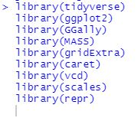
Packages Imported

Slide 7
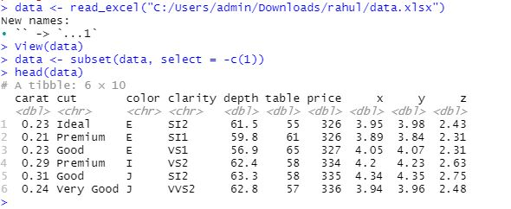
Loading Dataset

Slide 8


Dataset Dimensions and Removing Duplicate values in table

Slide 9
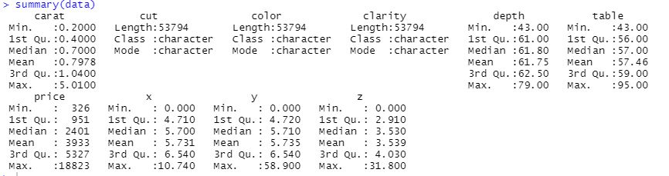
Summary of Dataset

Slide 10
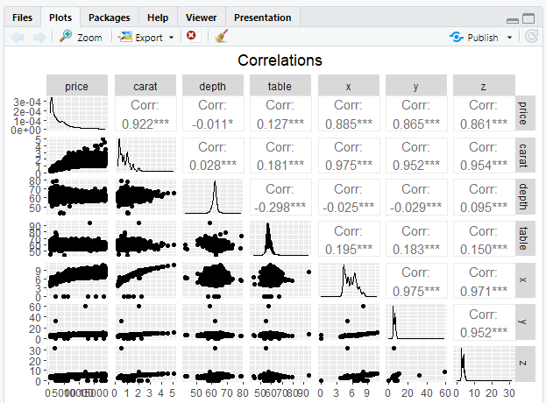
EDA -Correlations between pairs of numerical variables

Slide 11
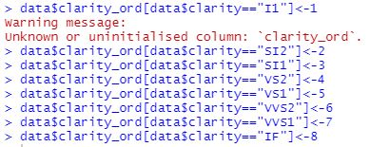
Perform One-Hot Encoding on Data
We would perform one-hot encoding to convert a categorical variable that contains in clarity, color and cut columns into new variables that contain only 0 and 1 values.
Clarity Column:

Slide 12
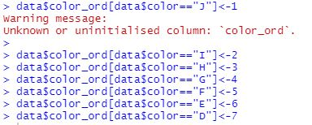
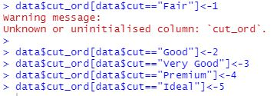
Color Column:
Cut Column:

Slide 13
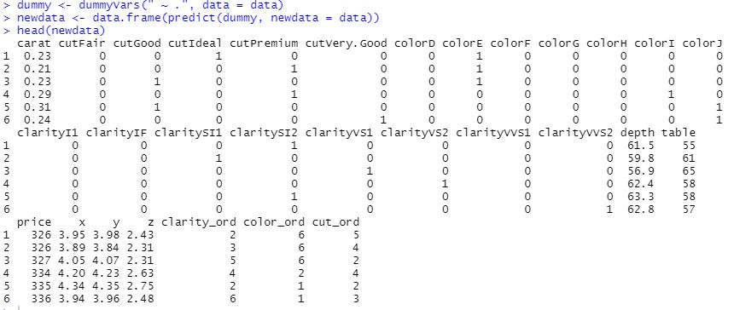
One-Hot Encoded Data after Applying

Slide 14
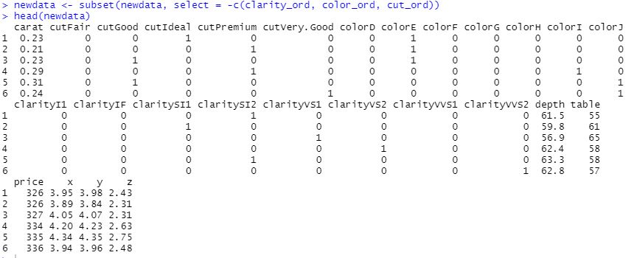
Drop the Original Categorical Variables -> { clarity_ord, color_ord, cut_ord

Slide 15

Train-Test Split Procedure
The procedure involves taking a dataset and dividing it into two subsets.
Train Dataset: Used to fit the machine learning model.
Test Dataset: Used to evaluate the fit machine learning model.

Slide 16
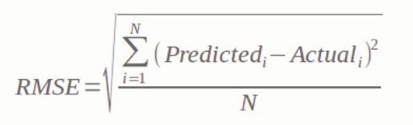

Metrics for Evaluating Regression Model Performance
=> The Root Mean Square Error is measured by taking the square root of the average of the squared difference between the prediction and the actual value.

Slide 17
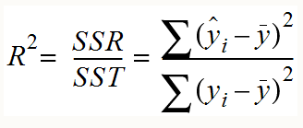

=> Coefficient of Determination or R^2:
It measures how well the actual outcomes are replicated by the regression line. It helps you to understand how well the independent variable adjusted with the variance in your model. That means how good is your model for a dataset.

Slide 18
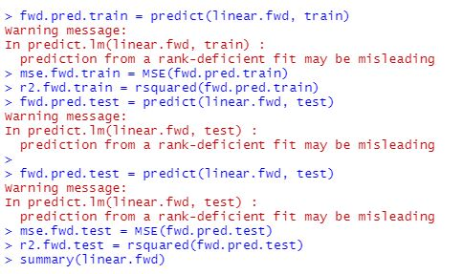
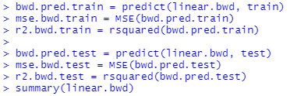
Modeling Techniques
Stepwise Linear Regression-
Stepwise regression is a technique that iteratively evaluates each independent variable's statistical significance in a linear regression model.
Forward selection Backward selection

Slide 19
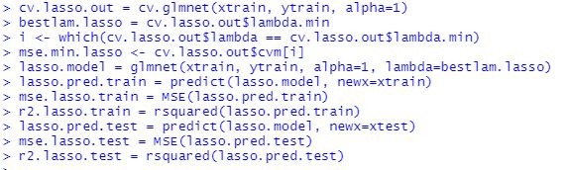
Linear Regression - LASSO
This is a regularization technique used in feature selection using a Shrinkage method also referred to as the penalized regression method. Lasso is short for Least Absolute Shrinkage and Selection Operator, which is used both for regularization and model selection. If a model uses the L1 regularization technique, then it is called lasso regression.
Code:

Slide 20
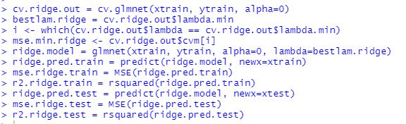
Linear Regression - Ridge
Similar to the lasso regression, ridge regression puts a similar constraint on the coefficients by introducing a penalty factor. However, while lasso regression takes the magnitude of the coefficients, ridge regression takes the square.
Ridge regression is also known as L2 Regularization.
Code:

Slide 21
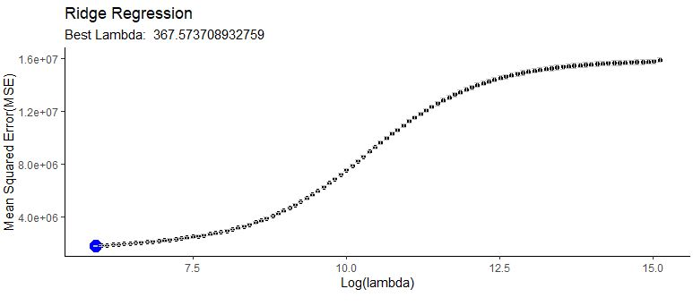
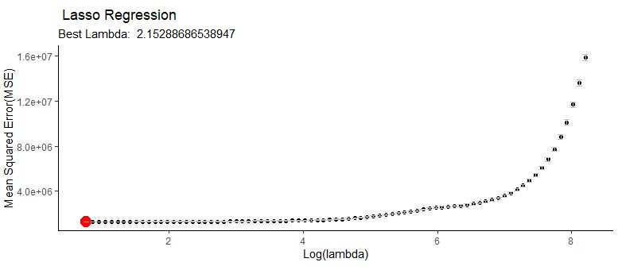
Mean Square Error Comparison

Slide 22





Result:
MSE Score:
R Squared Score:

Slide 23
Conclusion
By comparing Lasso regression or L1 Regularization got better than other models.
The amount of shrinkage for each method is determined by lambda, a tuning parameter.
Lambda was chosen for each method by 10-fold cross validation using the mean squared error on the training set to mersure performace.
The optimal lambda for ridge regression is 367.57 and optimal lambda for lasso model is 2.1588
Lasso is a more accurate model compared to ridge regession.

Slide 24
Thank you

